Slide 1
Moore Medical Corporation
Case Study Presented by:
Andrew Metcalf
Sandra Riebel
Joseph Jerusa
Robert Buchanan
Ansel Colvin

Slide 2
Problem Statement
The problem is that Moore Medical needs Customer Relationship Management (CRM) software that will allow Moore Medical to improve their ability to sense and respond to customer desires. Moore Medical desires to win new customers as well as keep their existing ones by increasing the interaction with its narrow group of market practitioner customers.

Slide 3
Key Issues Moore faces:
Churn rate too high (between 30% and 35%, while industry average is 25%)
Share of wallet too low
Product family too narrow (Moore does not stock all requirements for customers)
Perfect Orders are 68%; remaining 32% included 17% of split shipments, 10% back orders, and 5% late shipments; everything but late shipments can be resolved by better demand planning and if that is achieved they will have surpassed their perfect order goal of 90%

Slide 4
Key Issues Moore faces:
ERP Issues
Bids and Quotes – Creating and Retrieving quotes became cumbersome
Does not offer a total marketing campaign solution
Order Entry became more difficult
New account setup adds much time to customer calls
New accounts can’t be reviewed with existing ones

Slide 5
Moore Medical Alternatives Option # 1
Purchase and implement a new CRM (Customer Relationship Management) System.
The list price for the product is $500,000.00
In addition, Moore would have to purchase a technology escrow agreement for $2,500.00.
A customer care support system is also needed and it will cost $7,500.00 per/month.
For a one year subscription to the customer care support system this will add $90,000.00 to their investment.
The total cost to implement this new system will cost Moore Medical Corporation $592,500.00.
Benefit: Makes processing bids and quotes with their customers easier and allows them to have an integrated network through all of their channels such as phone, E-mail, and web.

Slide 6
Moore Medical Alternatives Option # 2
Install bolt-on modules to their existing ERP system.
Module 1= Demand planning
Benefit: Purchase based on previous sales history and expected future activity.
Module 2= Warehouse transfer system
Benefit: Check all distribution centers for excess stock before an order is placed to a vendor.
Module 3= Deal management
Benefit: Compare and analyze different vendor deals to determine optimal stock levels.
Module 4= Stock simulations
Benefit: Determine customer service levels that would result from different stock levels.
Estimated cost per module is $300,000.00.
4 modules * $300,000.00 each = Total cost of $1,200,000.00.

Slide 7
Moore Medical Alternatives Options # 3 and 4
Option # 3
Install Both the CRM system and the bolt-on modules for the existing ERP system.
Benefits: Achieving the benefits of the CRM system and also being able to choose which modules they would like to add to their ERP system.
Cost: A base cost of $592,500.00 + $300,000.00 for each module they choose to integrate.
1 Module = $892,500.00
2 Modules = $1,192,500.00
3 Modules = $1,492,500.00
4 Modules = $1,792,500.00
Option # 4
Moore could choose not to purchase either. This option would require them to try and fix their problems with their current ERP system because it was a very costly investment of $7,000,000.00.

Slide 8
Analysis – Option A
Clarify CRM (Customer Relationship Management)
Comprehensive set of tools for managing a company’s interactions with sales prospects, customers, and clients.
Focus on sales and customer relationships.
Integrated records bringing together customers from every channel.
Greater visibility.
Expensive.

Slide 9
Analysis – Option B
Bolt-Ons
J.D. Edwards ERP (Enterprise Resource Planning) add-on modules.
Problems with the existing system:
Bid and quotes inefficient.
Lacks marketing functionality.
Over-complicated order entry.
New account setup difficult and complex.
Weak forecasting.
Complexity a major issue even when lack of functionality is not.

Slide 10
Analysis – Option C & D
Combination of Clarify CRM and Bolt-Ons.
Expensive.
Difficult to implement.
Would require huge amounts of adaptation and acceptance from internal users.
No upgrades
Saves money.
Unfavorable for long-term growth.

Slide 11
Enterprise Systems
Supply Chain
Management
(SCM)
Enterprise Resource
Planning
(ERP)
Customer Relationship
Management
(CRM)
It is important to understand where the CRM system fits in the overall enterprise
systems model for a company. While there are many other systems in a company’s
portfolio, these are the three main components: the ERP system is the internal
control system or software that runs the main operations of the company, the supply
chain management system controls the supply of materials and services needed to
satisfy the manufacturing, distribution and other materiel requirements of the
company, and the CRM System manages the marketing, sales and customer
functions of the customer relationship. Typically the ERP system is the data
repository for the SCM and ERP systems.

Slide 12
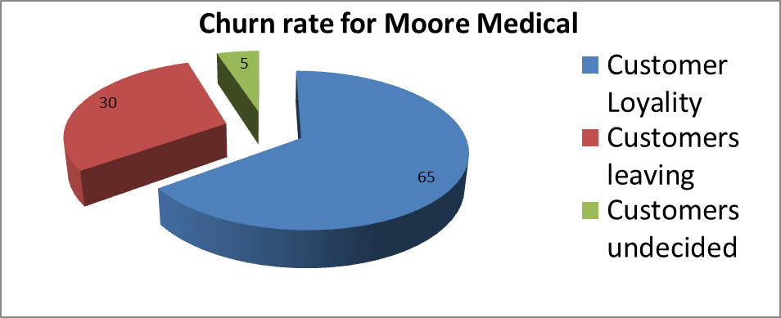
Why care about customers
Average company loses half its customers over a five year period.
5% increase in customer retention can lead to a considerable rise in net present value profits
Typically companies spend 5 times more on acquisition than retention
65-85% customers who deflect say they were satisfied with the supplier
A happy customer tells five people, a dissatisfied customer tells nine

Slide 13
CRM
Benefits
Profit
Cost
Customer Retention
Marketing Cost
Wallet Share
Sales Cost
Up-Sale/ Cross Sell
Service Cost

Slide 14
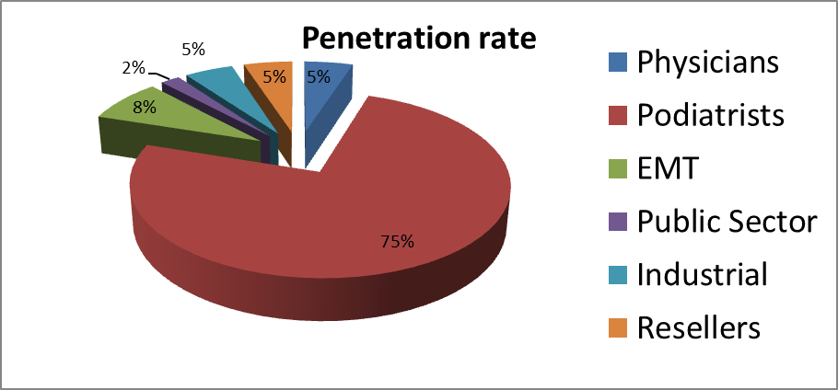
ERP bolt-ons
Product line – in 2001 more than
8,500 products, still considered
a fraction of all products in the
Medical supplies marketplace.
Moore’s strategy was to provide
a one-stop place for all the
products the customers needed and to dominate their orders.
Markets – Moore divided its customers into 6 groups: Physicians,
Podiatrists, Emergency Medical Services, Public Sector, Correction Facilities, Industrial, and Resellers.
Demand planning
Warehouse transfer system
Deal management
Stock simulations

Slide 15
ERP bolt-ons
A Performance Measure
The Perfect Order – Moore created this concept
based on a performance measurement system
developed by the company in late 2000. The “perfect order” had all of the items in stock, was shipped on time from the closest distribution center and arrived on time, damage free.
Moore’s accuracy was only 68%
*2000 orders per day and 17% have to be split between to different distribution centers at a cost of $2.82 per shipment. This cost is absorbed by Moore Medical. 340 x $2.82 = 958.80 per day cost to the company. If Moore Medical work an average of 20 day per month this would result in a $19,176./month cost to the company.

Slide 16
Conclusion
Technology Solutions
CRM from Clarify Consultants
ERP bolt-ons
> implementation
> training

Slide 17
conclusion
Strategies for Implementation
Moore is looking to optimize internal functions and predict market
demand though a CRM system
Know corporate goals and support these goals through implementation selection
Ensure the skills, knowledge and associated behaviors required by the
workforce support the implementation
Change the compensation of the workforce to achieve the
desired behaviors and cultural shifts and motivate employees
to rally behind strategy
Plan ERP bolt-ons and CRM to fit in with the vision
and goals of the company
Build everywhere conservatively
Train employees
Both short and long term ROI’s should be realized as long as Moore stays customer focused and true to their aim of being a one-stop shop that meets all their customer’s needs

